Slide 1
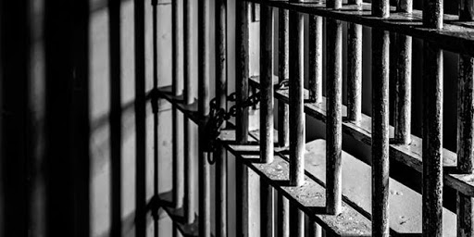

Prison Management System
Group 1

Slide 2

What is our Purpose ?
Our goal is to manage a prison fast, easily and safely.
To make this let’s look at our modules in the system.

Slide 3
ADMINISTRATOR
Administrator manage governors.
Add, remove or appoint governor.

Slide 4
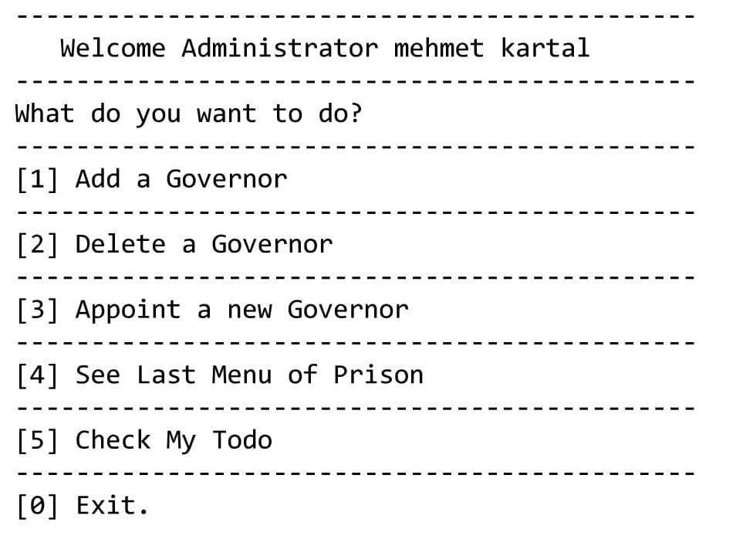
ADMINISTRATOR
When Administrator enters the system, Shown a menu like as right picture.

Slide 5
addGovernor
User enters ID, name, surname, password, blood group, last control result, height, weight, pulse, shift time, shift days, block and floor.
removeGovernor
User enters ID to remove.
appointGovernor
User first enters ID to remove, then enters ID, name, surname, password, blood group, last control result, height, weight, pulse, shift time, shift days, block and floor to add.

Slide 6

GOVERNOR
Governor adds, removes and updates
personnel and inmates.
Also, he/she regulates the jobs of the personnel.

Slide 7
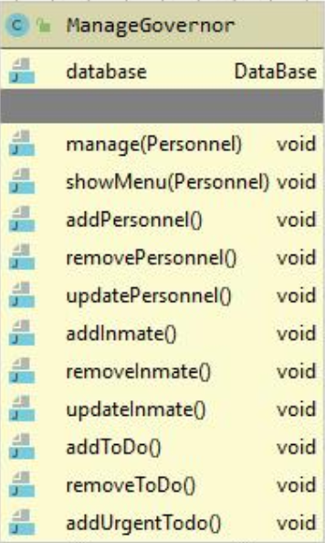
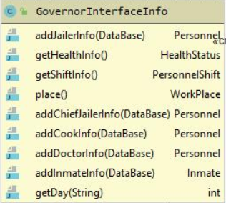
Database hold the Personnel list as SKIP LIST. Governor adds, deletes and updates personnel using this skip list.
Database hold the Inmates as AVLTree. Governor adds, removes and updates inmates using this AVLTREE.
Database hold to-do’s two different types. Todos that was done before keeps as a LIST. Others keeps as a PRIORITYQUE.

Slide 8
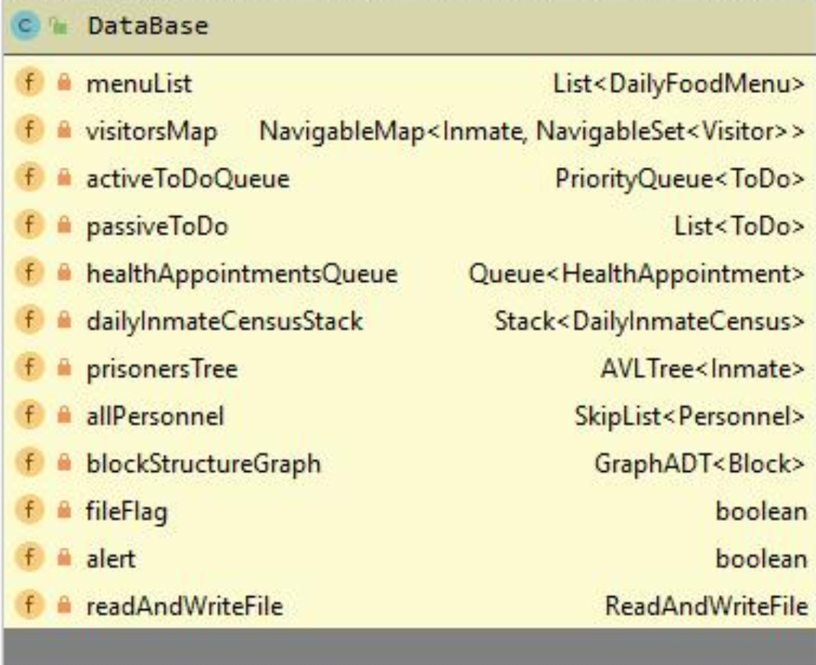
The reason of the using AVLTree for keeping inmate, we can search an inmate in O(logn) time. The reason of the using PriorityQueue for keeping personnel’s tasks, personnel must do must important job to the other jobs. The reason of the using Skip List sor keeping personnel, we can search a personnel in O(logn) time and it provide us a fast search while password checking.

Slide 9
addPersonnel method adds personel in Skip List.
deletePersonnel method removes personel in SkipList.
updatePersonnel method updates personel informations.
In all these methods,
If the personel is not available, the program gives an error.
addInmate method adds inmate in AVLTree.
removeInmate method removes inmate in AVLTree.
updateInmate method updates inmates informations.
In all these methods,
If the inmate is not available, the program gives an error.
addToDo method adds to-do in priority queue.
removeToDo method removes to-do in priority queue. Removed to-do adds passive to-do list.
addUrgentToDo method adds urgent to-do. the importance of these jobs is greater than others.
In all these methods,
If the to-do is not available, the program gives an error.

Slide 10

CHIEF JAILOR
- Set Alert && Undo Alert
- Manage Visitor Information
- Set Jailer Shift Hours
- Set Jailer Department

Slide 11
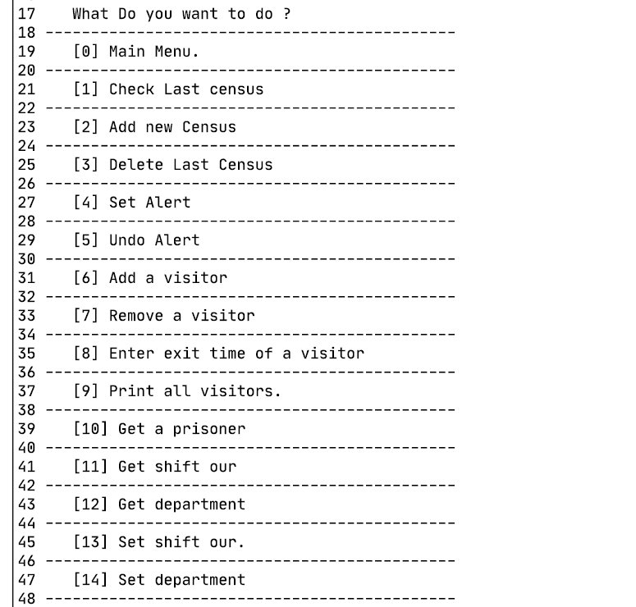
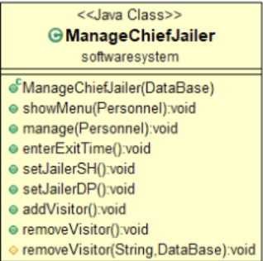
First of all, it is necessary to add chief jailer as staff in prison manage system. Then the chief jailer id and password must be entered. As a result, we will see this menu.
Manage Chief class class diagram

Slide 12
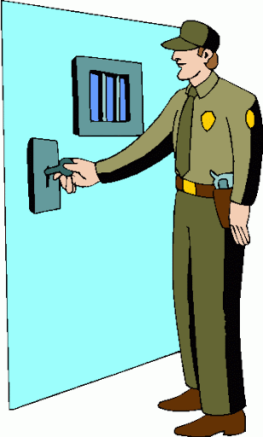
JAILOR
- Manage Census Inmates
- Set Alert && Undo Alert
- Manage Health Appointment of Inmates
- Also can get a info about inmates

Slide 13
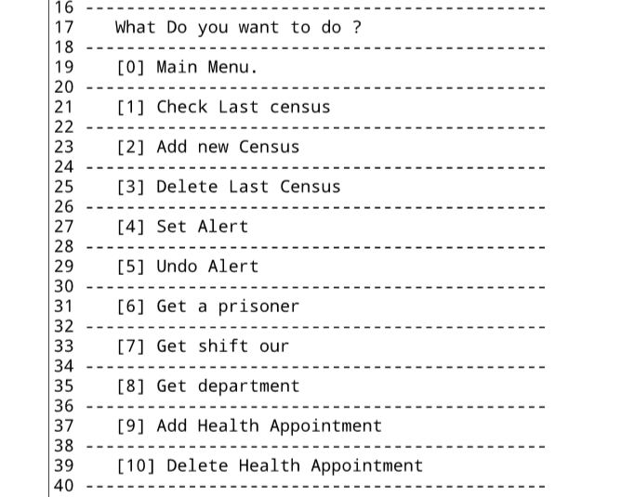
First of all, it is necessary to add jailer as staff in prison manage system. Then the jailer id and password must be entered. As a result, we will see this menu.

Slide 14

Doctor
Doctor is in charge of all the sick inmates
It takes their appointments made by jailer and examines inmates that are not feeling feel

Slide 15
Health appointment
All health appointment are stored in the database in a queue data structure
Doctor takes it from the queue and examines patients
This way first person to get an appointment is the first one to enter it

Slide 16
Health status
During examination doctor updates patient's health status
This class contains inmate's:
-blood group
-last control's result
-height
-weight
-pulse

Slide 17

Cook
Cooks organize the menu and enter the menu into the system.
Add, remove or change food list to menu and remove.

Slide 18
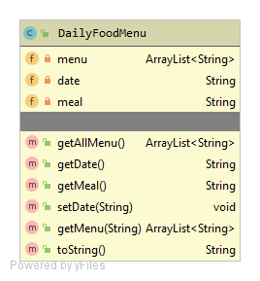
DaIlyFoodmenu
DATABASE HOLD THE MENU LİST AS LINKED LIST and ın class menu holdıng as a strıng array lıst. Generally holdıng food names ın that meal.
Menu assign ın constructor. When user want to change menu ıt wıll be ın cook class.

Slide 19
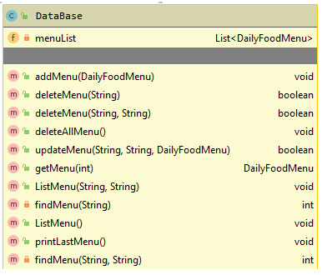
If cook want to do anythıng ın menu, need to create menu as a daıylyfoodmenu class. And add, change or remove ıt ın database. Because all menu lıst holdıng ın database.

Slide 20
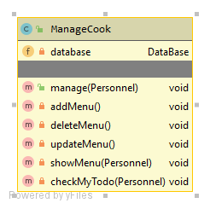
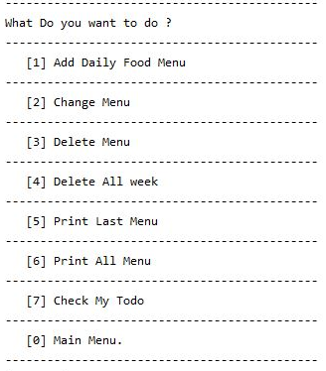
Cook
When cook enter the system and match ıd and password correctly, Shown a menu lıke as rıght pıcture.

Slide 21
addMenu
User firstly enter day and meal name for create a dailyFoodMenu. After that user will enter cooks name until to push ‘0’.
change Menu
User firstly enter day and meal name for matching in database. After that menu in database will remove and user will enter cooks name until to push ‘0’, and it will be add to database.
deleteMenu
There is three kind of deletion.
1. Delete just one meal. Cook need to enter day and meal, if it is exist it will be remove and return true.
2. Delete all day. Cook need to enter a day. , if it is exist it will be remove all menu in this day and return true.
3. Delete all menu in database.
printMenu
Print all menu in database.

Slide 22

Data Module

Slide 23
We used several data structure to keep our data in the system.
These are;
List
Queue
Stack
Balanced Binary Search Tree.
Priority Queue
Set – Map
SkipList
Graph
Outside of the system we used Files to store whole data.

Slide 24

Our General Data in the system is;
Daily Food Menu
menu | date | meal
Daily Inmate census
number of inmate | date
Health Appointment
apID | date | ownerID | explanation | healthStatus
Health Status
bloodGroup | lastControlResult | height | weight | pulse
Inmate
id | full name | crimeType | exitTime | exitTime | healthStatus
Personnel
id | name | surname | password | job | healthStatus | shift | place
Visitor
name | surname | tcNumber | inmateNumber | telephoneNumber | date | entranceTime

Slide 25
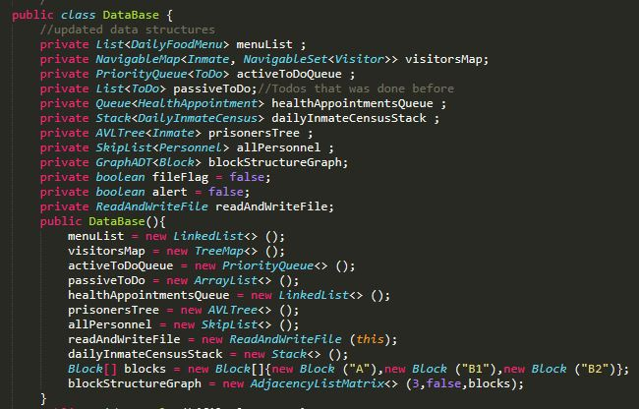

Slide 26
Thank You

